Slide 1
Find the prime implicants of the Boolean function
  F(w, x, y, z) = ∑(0, 2, 4, 5, 6, 7, 8, 10, 13, 14, 15)

Slide 2
Find the prime implicants of the Boolean function
  F(w, x, y, z) = ∑(0, 2, 4, 5, 6, 7, 8, 10, 13, 14, 15)
yz
 | 00 | 01 | 11 | 10
00
01
11
10
wx

Slide 3
Find the prime implicants of the Boolean function
  F(w, x, y, z) = ∑(0, 2, 4, 5, 6, 7, 8, 10, 13, 14, 15)
yz
 | 00 | 01 | 11 | 10
00 | 1 |  |  | 1
01 | 1 | 1 | 1 | 1
11 |  | 1 | 1 | 1
10 | 1 |  |  | 1
wx

Slide 4
Find the prime implicants of the Boolean function
  F(w, x, y, z) = ∑(0, 2, 4, 5, 6, 7, 8, 10, 13, 14, 15)
yz
 | 00 | 01 | 11 | 10
00 | 1 |  |  | 1
01 | 1 | 1 | 1 | 1
11 |  | 1 | 1 | 1
10 | 1 |  |  | 1
wx
1 | x’z’
2 | xz
3 | xy
4 | w’x
5 | w’z’
6 | yz’

Slide 5
Find the prime implicants of the Boolean function
  F(w, x, y, z) = ∑(0, 2, 4, 5, 6, 7, 8, 10, 13, 14, 15)
yz
 | 00 | 01 | 11 | 10
00 | 1 |  |  | 1
01 | 1 | 1 | 1 | 1
11 |  | 1 | 1 | 1
10 | 1 |  |  | 1
wx
1 | x’y’
2 | xz
3 | xy
4 | w’x
5 | w’z’
6 | yz’

Slide 6
Find the prime implicants of the Boolean function
  F(w, x, y, z) = ∑(0, 2, 4, 5, 6, 7, 8, 10, 13, 14, 15)
yz
 | 00 | 01 | 11 | 10
00 | 1 |  |  | 1
01 | 1 | 1 | 1 | 1
11 |  | 1 | 1 | 1
10 | 1 |  |  | 1
wx
1 | x’y’
2 | xz
3 | xy
4 | w’x
5 | w’z’
6 | yz’

Slide 7
Find the prime implicants of the Boolean function
  F(w, x, y, z) = ∑(0, 2, 4, 5, 6, 7, 8, 10, 13, 14, 15)
yz
 | 00 | 01 | 11 | 10
00 | 1 |  |  | 1
01 | 1 | 1 | 1 | 1
11 |  | 1 | 1 | 1
10 | 1 |  |  | 1
wx
1 | x’y’
2 | xz
3 | xy
4 | w’x
5 | w’z’
6 | yz’

Slide 8
Find the prime implicants of the Boolean function
  F(w, x, y, z) = ∑(0, 2, 4, 5, 6, 7, 8, 10, 13, 14, 15)
yz
 | 00 | 01 | 11 | 10
00 | 1 |  |  | 1
01 | 1 | 1 | 1 | 1
11 |  | 1 | 1 | 1
10 | 1 |  |  | 1
wx
1 | x’y’
2 | xz
3 | xy
4 | w’x
5 | w’z’
6 | yz’

Slide 9
Find the prime implicants of the Boolean function
  F(w, x, y, z) = ∑(0, 2, 4, 5, 6, 7, 8, 10, 13, 14, 15)
yz
 | 00 | 01 | 11 | 10
00 | 1 |  |  | 1
01 | 1 | 1 | 1 | 1
11 |  | 1 | 1 | 1
10 | 1 |  |  | 1
wx
1 | x’y’
2 | xz
3 | xy
4 | w’x
5 | w’z’
6 | yz’

Slide 10
  Five-variable K-map
Map for more than four variables becomes complicated

Slide 11
  Five-variable K-map
Map for more than four variables becomes complicated
  Five-variable map: two four-variable map

Slide 12
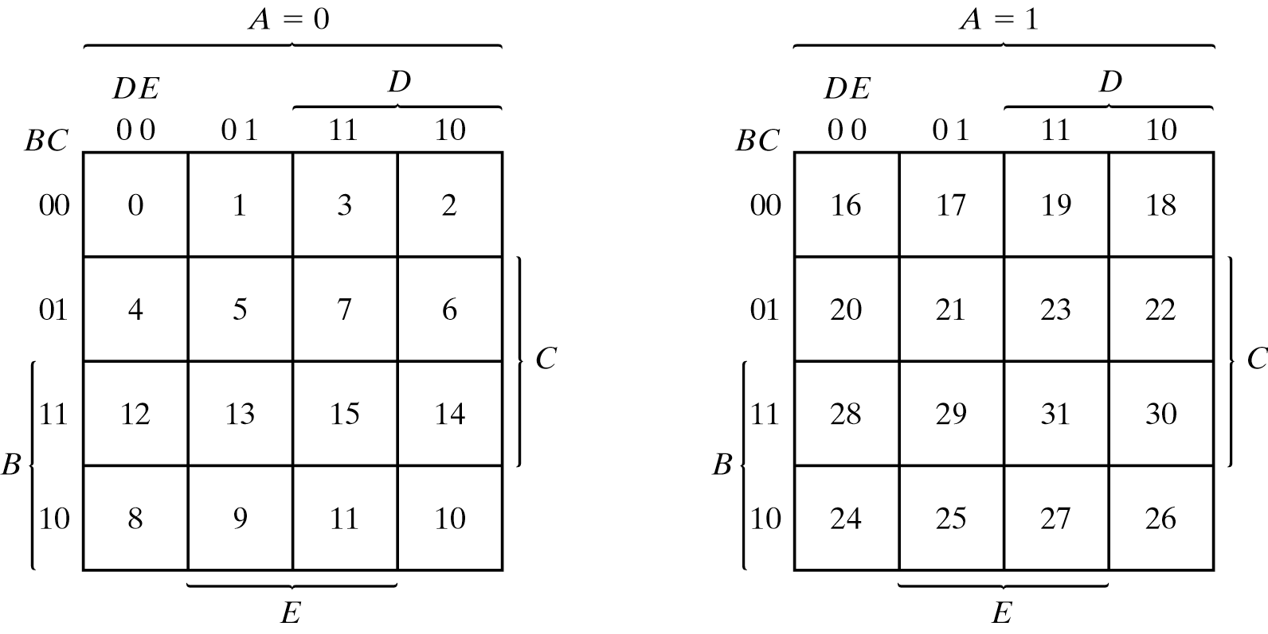
  Five-variable K-map
Map for more than four variables becomes complicated
  Five-variable map: two four-variable map

Slide 13
  Five-variable K-map
Map for more than four variables becomes complicated
  Five-variable map: two four-variable map

Slide 14
  Five-variable K-map
Map for more than four variables becomes complicated
  Five-variable map: two four-variable map

Slide 15
  Five-variable K-map
Map for more than four variables becomes complicated
  Five-variable map: two four-variable map

Slide 16
  Five-variable K-map
Map for more than four variables becomes complicated
  Five-variable map: two four-variable map
A’B’C’D’E’

Slide 17
  Five-variable K-map
Map for more than four variables becomes complicated
  Five-variable map: two four-variable map
A’B’C’D’E’
AB’C’D’E’

Slide 18
  Five-variable K-map
Map for more than four variables becomes complicated
  Five-variable map: two four-variable map
A’B’C’D’E’
AB’C’D’E’
A’BCDE

Slide 19
  Five-variable K-map
Map for more than four variables becomes complicated
  Five-variable map: two four-variable map
A’B’C’D’E’
AB’C’D’E’
A’BCDE
ABCDE

Slide 20
  Five-variable K-map
Squares in the same position but across different maps are adjacent

Slide 21
  Five-variable K-map
  F = Σ(0, 2, 4, 6, 9, 13, 21, 23, 25, 29, 31)

Slide 22
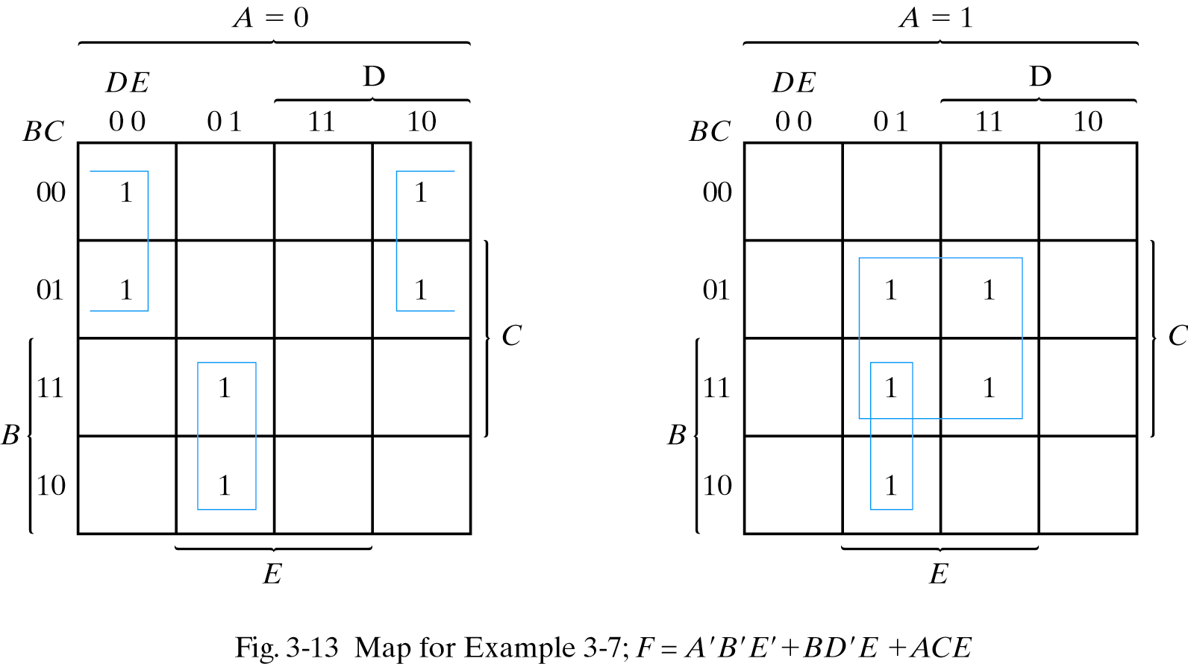
  Five-variable K-map
  F = Σ(0, 2, 4, 6, 9, 13, 21, 23, 25, 29, 31)

Slide 23
  Five-variable K-map
  F = Σ(0, 2, 4, 6, 9, 13, 21, 23, 25, 29, 31)
0 | A | 0
 | B | 0
 | C | 0
 | D | 0
 | E | 0

Slide 24
  Five-variable K-map
  F = Σ(0, 2, 4, 6, 9, 13, 21, 23, 25, 29, 31)
2 | A | 0
 | B | 0
 | C | 0
 | D | 1
 | E | 0

Slide 25
  Five-variable K-map
  F = Σ(0, 2, 4, 6, 9, 13, 21, 23, 25, 29, 31)
21 | A | 1
 | B | 0
 | C | 1
 | D | 0
 | E | 1

Slide 26
  Five-variable K-map
  F = Σ(0, 2, 4, 6, 9, 13, 21, 23, 25, 29, 31)
31 | A | 1
 | B | 1
 | C | 1
 | D | 1
 | E | 1

Slide 27
  Five-variable K-map
  F = Σ(0, 2, 4, 6, 9, 13, 21, 23, 25, 29, 31)

Slide 28
  Five-variable K-map
  F = Σ(0, 2, 4, 6, 9, 13, 21, 23, 25, 29, 31)

Slide 29
  Five-variable K-map
  F = Σ(0, 2, 4, 6, 9, 13, 21, 23, 25, 29, 31)
BD’E

Slide 30
  Five-variable K-map
  F = Σ(0, 2, 4, 6, 9, 13, 21, 23, 25, 29, 31)
BD’E

Slide 31
  Five-variable K-map
  F = Σ(0, 2, 4, 6, 9, 13, 21, 23, 25, 29, 31)
BD’E
ACE

Slide 32
  Five-variable K-map
  F = Σ(0, 2, 4, 6, 9, 13, 21, 23, 25, 29, 31)
BD’E
ACE

Slide 33
  Five-variable K-map
  F = Σ(0, 2, 4, 6, 9, 13, 21, 23, 25, 29, 31)
BD’E
ACE
A’B’E’

Slide 34
  Five-variable K-map
  F = BD’E + ACE + A’B’E’
BD’E
ACE
A’B’E’

Slide 35
  Sum of Products Simplification
  F = Σ(0, 1, 2, 5, 8, 9, 10)

Slide 36
  Sum of Products Simplification
  F = Σ(0, 1, 2, 5, 8, 9, 10)
CD
 | 00 | 01 | 11 | 10
00 | 1 | 1 |  | 1
01 |  | 1
11
10 | 1 | 1 |  | 1
AB

Slide 37
  Sum of Products Simplification
  F = Σ(0, 1, 2, 5, 8, 9, 10)
CD
 | 00 | 01 | 11 | 10
00 | 1 | 1 |  | 1
01 |  | 1
11
10 | 1 | 1 |  | 1
AB

Slide 38
  Sum of Products Simplification
  F = Σ(0, 1, 2, 5, 8, 9, 10)
CD
 | 00 | 01 | 11 | 10
00 | 1 | 1 |  | 1
01 |  | 1
11
10 | 1 | 1 |  | 1
AB
B’D’

Slide 39
  Sum of Products Simplification
  F = Σ(0, 1, 2, 5, 8, 9, 10)
CD
 | 00 | 01 | 11 | 10
00 | 1 | 1 |  | 1
01 |  | 1
11
10 | 1 | 1 |  | 1
AB
B’D’

Slide 40
  Sum of Products Simplification
  F = Σ(0, 1, 2, 5, 8, 9, 10)
CD
 | 00 | 01 | 11 | 10
00 | 1 | 1 |  | 1
01 |  | 1
11
10 | 1 | 1 |  | 1
AB
B’D’
B’C’

Slide 41
  Sum of Products Simplification
  F = Σ(0, 1, 2, 5, 8, 9, 10)
CD
 | 00 | 01 | 11 | 10
00 | 1 | 1 |  | 1
01 |  | 1
11
10 | 1 | 1 |  | 1
AB
B’D’
B’C’

Slide 42
  Sum of Products Simplification
  F = Σ(0, 1, 2, 5, 8, 9, 10)
CD
 | 00 | 01 | 11 | 10
00 | 1 | 1 |  | 1
01 |  | 1
11
10 | 1 | 1 |  | 1
AB
B’D’
B’C’
A’C’D

Slide 43
  Sum of Products Simplification
  F = Σ(0, 1, 2, 5, 8, 9, 10) = B’D’ + B’C’ + A’C’D
CD
 | 00 | 01 | 11 | 10
00 | 1 | 1 |  | 1
01 |  | 1
11
10 | 1 | 1 |  | 1
AB

Slide 44
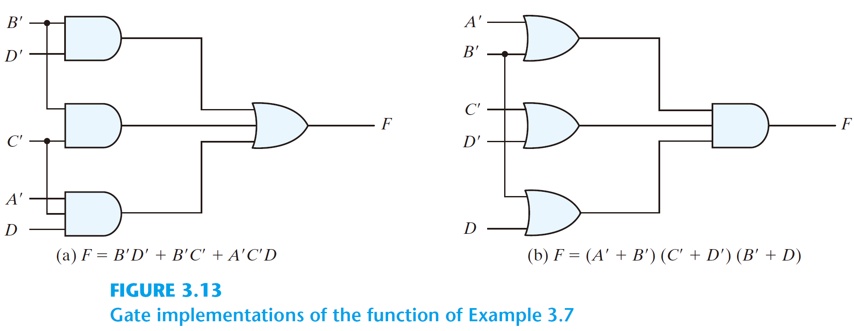
  Sum of Products Simplification
  F = Σ(0, 1, 2, 5, 8, 9, 10) = B’D’ + B’C’ + A’C’D
CD
 | 00 | 01 | 11 | 10
00 | 1 | 1 |  | 1
01 |  | 1
11
10 | 1 | 1 |  | 1
AB

Slide 45
  Product of Sums Simplification
Approach 1
  Simplified F’ in the form of sum of products
  Apply DeMorgan’s theorem F = (F’)’
  F’: sum of products → F: product of sums

Slide 46
  Product of Sums Simplification
  F = Σ(0, 1, 2, 5, 8, 9, 10)
CD
 | 00 | 01 | 11 | 10
00 | 1 | 1 |  | 1
01 |  | 1
11
10 | 1 | 1 |  | 1
AB

Slide 47
  Product of Sums Simplification
  F = Σ(0, 1, 2, 5, 8, 9, 10)
  F’ = Σ(3, 4, 6, 7, 11, 12, 13, 14, 15)
CD
 | 00 | 01 | 11 | 10
00 | 1 | 1 |  | 1
01 |  | 1
11
10 | 1 | 1 |  | 1
AB

Slide 48
  Product of Sums Simplification
  F = Σ(0, 1, 2, 5, 8, 9, 10)
  F’ = Σ(3, 4, 6, 7, 11, 12, 13, 14, 15)
CD
CD
 | 00 | 01 | 11 | 10
00 | 1 | 1 |  | 1
01 |  | 1
11
10 | 1 | 1 |  | 1
 | 00 | 01 | 11 | 10
00 |  |  | 1
01 | 1 |  | 1 | 1
11 | 1 | 1 | 1 | 1
10 |  |  | 1
AB
AB

Slide 49
  Product of Sums Simplification
  F’ = Σ(3, 4, 6, 7, 11, 12, 13, 14, 15)
CD
 | 00 | 01 | 11 | 10
00 |  |  | 1
01 | 1 |  | 1 | 1
11 | 1 | 1 | 1 | 1
10 |  |  | 1
AB

Slide 50
  Product of Sums Simplification
  F’ = Σ(3, 4, 6, 7, 11, 12, 13, 14, 15)
CD
 | 00 | 01 | 11 | 10
00 |  |  | 1
01 | 1 |  | 1 | 1
11 | 1 | 1 | 1 | 1
10 |  |  | 1
AB

Slide 51
  Product of Sums Simplification
  F’ = Σ(3, 4, 6, 7, 11, 12, 13, 14, 15)
CD
 | 00 | 01 | 11 | 10
00 |  |  | 1
01 | 1 |  | 1 | 1
11 | 1 | 1 | 1 | 1
10 |  |  | 1
AB

Slide 52
  Product of Sums Simplification
  F’ = Σ(3, 4, 6, 7, 11, 12, 13, 14, 15)
CD
 | 00 | 01 | 11 | 10
00 |  |  | 1
01 | 1 |  | 1 | 1
11 | 1 | 1 | 1 | 1
10 |  |  | 1
AB
CD

Slide 53
  Product of Sums Simplification
  F’ = Σ(3, 4, 6, 7, 11, 12, 13, 14, 15)
CD
 | 00 | 01 | 11 | 10
00 |  |  | 1
01 | 1 |  | 1 | 1
11 | 1 | 1 | 1 | 1
10 |  |  | 1
AB
CD

Slide 54
  Product of Sums Simplification
  F’ = Σ(3, 4, 6, 7, 11, 12, 13, 14, 15)
CD
 | 00 | 01 | 11 | 10
00 |  |  | 1
01 | 1 |  | 1 | 1
11 | 1 | 1 | 1 | 1
10 |  |  | 1
AB
CD
AB

Slide 55
  Product of Sums Simplification
  F’ = Σ(3, 4, 6, 7, 11, 12, 13, 14, 15)
CD
 | 00 | 01 | 11 | 10
00 |  |  | 1
01 | 1 |  | 1 | 1
11 | 1 | 1 | 1 | 1
10 |  |  | 1
AB
CD
AB

Slide 56
  Product of Sums Simplification
  F’ = Σ(3, 4, 6, 7, 11, 12, 13, 14, 15)
CD
 | 00 | 01 | 11 | 10
00 |  |  | 1
01 | 1 |  | 1 | 1
11 | 1 | 1 | 1 | 1
10 |  |  | 1
AB
CD
AB
BD’

Slide 57
  Product of Sums Simplification
  F’ = Σ(3, 4, 6, 7, 11, 12, 13, 14, 15)
  = CD + AB + BD’
CD
 | 00 | 01 | 11 | 10
00 |  |  | 1
01 | 1 |  | 1 | 1
11 | 1 | 1 | 1 | 1
10 |  |  | 1
AB

Slide 58
  Product of Sums Simplification
  F’ = Σ(3, 4, 6, 7, 11, 12, 13, 14, 15)
  = CD + AB + BD’
  Apply DeMorgan's theorem
CD
 | 00 | 01 | 11 | 10
00 |  |  | 1
01 | 1 |  | 1 | 1
11 | 1 | 1 | 1 | 1
10 |  |  | 1
AB

Slide 59
  Product of Sums Simplification
  F’ = Σ(3, 4, 6, 7, 11, 12, 13, 14, 15)
  = CD + AB + BD’
  Apply DeMorgan's theorem
  F = (C’ + D’)(A’ + B’)(B’ + D)
CD
 | 00 | 01 | 11 | 10
00 |  |  | 1
01 | 1 |  | 1 | 1
11 | 1 | 1 | 1 | 1
10 |  |  | 1
AB

Slide 60
  Product of Sums Simplification
  F’ = Σ(3, 4, 6, 7, 11, 12, 13, 14, 15)
  = CD + AB + BD’
  Apply DeMorgan's theorem
  F = (C’ + D’)(A’ + B’)(B’ + D)

Slide 61
  Product of Sums Simplification

Slide 62
  Product of Sums Simplification
Approach 2

Slide 63
  Product of Sums Simplification
  F = Σ(0, 1, 2, 5, 8, 9, 10)

Slide 64
  Product of Sums Simplification
  F = Σ(0, 1, 2, 5, 8, 9, 10)
CD
 | 00 | 01 | 11 | 10
00 | 1 | 1 |  | 1
01 |  | 1
11
10 | 1 | 1 |  | 1
AB

Slide 65
  Product of Sums Simplification
  F = Σ(0, 1, 2, 5, 8, 9, 10)
CD
 | 00 | 01 | 11 | 10
00 | 1 | 1 | 0 | 1
01 | 0 | 1 | 0 | 0
11 | 0 | 0 | 0 | 0
10 | 1 | 1 | 0 | 1
AB

Slide 66
  Product of Sums Simplification
  F = Σ(0, 1, 2, 5, 8, 9, 10)
CD
 | 00 | 01 | 11 | 10
00 | 1 | 1 | 0 | 1
01 | 0 | 1 | 0 | 0
11 | 0 | 0 | 0 | 0
10 | 1 | 1 | 0 | 1
AB

Slide 67
  Product of Sums Simplification
  F = Σ(0, 1, 2, 5, 8, 9, 10)
CD
 | 00 | 01 | 11 | 10
00 | 1 | 1 | 0 | 1
01 | 0 | 1 | 0 | 0
11 | 0 | 0 | 0 | 0
10 | 1 | 1 | 0 | 1
AB
CD

Slide 68
  Product of Sums Simplification
  F = Σ(0, 1, 2, 5, 8, 9, 10)
CD
 | 00 | 01 | 11 | 10
00 | 1 | 1 | 0 | 1
01 | 0 | 1 | 0 | 0
11 | 0 | 0 | 0 | 0
10 | 1 | 1 | 0 | 1
AB
CD

Slide 69
  Product of Sums Simplification
  F = Σ(0, 1, 2, 5, 8, 9, 10)
CD
 | 00 | 01 | 11 | 10
00 | 1 | 1 | 0 | 1
01 | 0 | 1 | 0 | 0
11 | 0 | 0 | 0 | 0
10 | 1 | 1 | 0 | 1
AB
CD
AB

Slide 70
  Product of Sums Simplification
  F = Σ(0, 1, 2, 5, 8, 9, 10)
CD
 | 00 | 01 | 11 | 10
00 | 1 | 1 | 0 | 1
01 | 0 | 1 | 0 | 0
11 | 0 | 0 | 0 | 0
10 | 1 | 1 | 0 | 1
AB
CD
AB

Slide 71
  Product of Sums Simplification
  F = Σ(0, 1, 2, 5, 8, 9, 10)
CD
 | 00 | 01 | 11 | 10
00 | 1 | 1 | 0 | 1
01 | 0 | 1 | 0 | 0
11 | 0 | 0 | 0 | 0
10 | 1 | 1 | 0 | 1
AB
CD
AB
BD’

Slide 72
  Product of Sums Simplification
  F = Σ(0, 1, 2, 5, 8, 9, 10)
  F’ = CD + AB + BD’
CD
 | 00 | 01 | 11 | 10
00 | 1 | 1 | 0 | 1
01 | 0 | 1 | 0 | 0
11 | 0 | 0 | 0 | 0
10 | 1 | 1 | 0 | 1
AB

Slide 73
  Product of Sums Simplification
  F = Σ(0, 1, 2, 5, 8, 9, 10)
  F’ = CD + AB + BD’
  Apply DeMorgan's theorem
CD
 | 00 | 01 | 11 | 10
00 | 1 | 1 | 0 | 1
01 | 0 | 1 | 0 | 0
11 | 0 | 0 | 0 | 0
10 | 1 | 1 | 0 | 1
AB

Slide 74
  Product of Sums Simplification
  F = Σ(0, 1, 2, 5, 8, 9, 10)
  F’ = CD + AB + BD’
  Apply DeMorgan's theorem
  F = (C’ + D’)(A’ + B’)(B’ + D)
CD
 | 00 | 01 | 11 | 10
00 | 1 | 1 | 0 | 1
01 | 0 | 1 | 0 | 0
11 | 0 | 0 | 0 | 0
10 | 1 | 1 | 0 | 1
AB

Slide 75
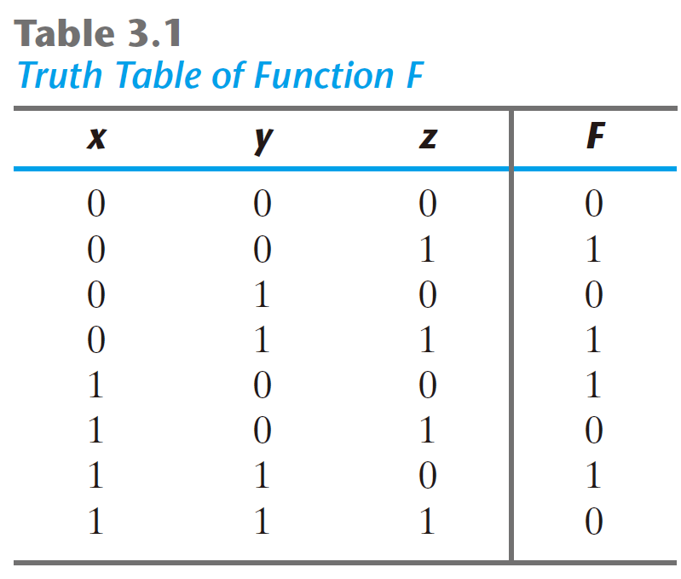
Consider the function defined in Table 3.1

Slide 76
Consider the function defined in Table 3.1
In sum-of-Minterm:

Slide 77
Consider the function defined in Table 3.1
In sum-of-Minterm:
In sum-of-Maxterm:

Slide 78
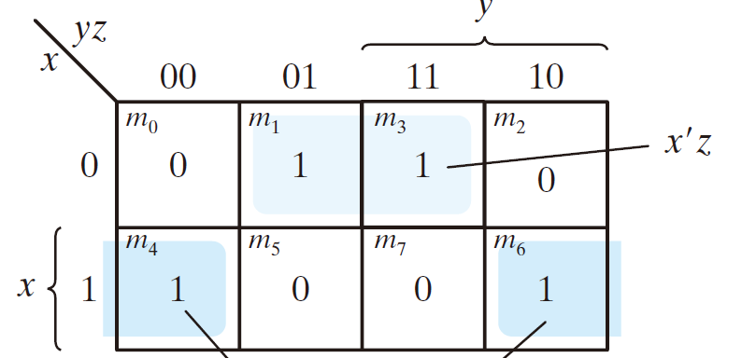
Consider the function defined in Table 3.1

Slide 79
Consider the function defined in Table 3.1

Slide 80
Consider the function defined in Table 3.1
F = x’z + xz’

Slide 81
Consider the function defined in Table 3.1
F = x’z + xz’

Slide 82
Consider the function defined in Table 3.1
F = x’z + xz’

Slide 83
Consider the function defined in Table 3.1
F = x’z + xz’
F’ = xz + x’z’

Slide 84
Consider the function defined in Table 3.1
F = x’z + xz’
F’ = xz + x’z’
  Apply DeMorgan's theorem

Slide 85
Consider the function defined in Table 3.1
F = x’z + xz’
F’ = xz + x’z’
  Apply DeMorgan's theorem
F = (x’ + z’)( x + z)

Slide 86
Simplify the Boolean function F(w, x, y, z) = ∑(0, 2, 8, 10, 12, 13, 14)
into (a) sum-of-product form (b) product-of –sum form

Slide 87
Simplify the Boolean function F(w, x, y, z) = ∑(0, 2, 8, 10, 12, 13, 14)
into (a) sum-of-product form (b) product-of –sum form
yz
 | 00 | 01 | 11 | 10
00 | 1 |  |  | 1
01
11 | 1 | 1 |  | 1
10 | 1 |  |  | 1
wx

Slide 88
Simplify the Boolean function F(w, x, y, z) = ∑(0, 2, 8, 10, 12, 13, 14)
into (a) sum-of-product form (b) product-of –sum form
yz
 | 00 | 01 | 11 | 10
00 | 1 | 0 | 0 | 1
01 | 0 | 0 | 0 | 0
11 | 1 | 1 | 0 | 1
10 | 1 | 0 | 0 | 1
wx

Slide 89
Simplify the Boolean function F(w, x, y, z) = ∑(0, 2, 8, 10, 12, 13, 14)
into (a) sum-of-product form (b) product-of –sum form
yz
 | 00 | 01 | 11 | 10
00 | 1 | 0 | 0 | 1
01 | 0 | 0 | 0 | 0
11 | 1 | 1 | 0 | 1
10 | 1 | 0 | 0 | 1
wx

Slide 90
Simplify the Boolean function F(w, x, y, z) = ∑(0, 2, 8, 10, 12, 13, 14)
into (a) sum-of-product form (b) product-of –sum form
yz
 | 00 | 01 | 11 | 10
00 | 1 | 0 | 0 | 1
01 | 0 | 0 | 0 | 0
11 | 1 | 1 | 0 | 1
10 | 1 | 0 | 0 | 1
wx
x’z’

Slide 91
Simplify the Boolean function F(w, x, y, z) = ∑(0, 2, 8, 10, 12, 13, 14)
into (a) sum-of-product form (b) product-of –sum form
yz
 | 00 | 01 | 11 | 10
00 | 1 | 0 | 0 | 1
01 | 0 | 0 | 0 | 0
11 | 1 | 1 | 0 | 1
10 | 1 | 0 | 0 | 1
wx
x’z’

Slide 92
Simplify the Boolean function F(w, x, y, z) = ∑(0, 2, 8, 10, 12, 13, 14)
into (a) sum-of-product form (b) product-of –sum form
yz
 | 00 | 01 | 11 | 10
00 | 1 | 0 | 0 | 1
01 | 0 | 0 | 0 | 0
11 | 1 | 1 | 0 | 1
10 | 1 | 0 | 0 | 1
wx
x’z’
wz’

Slide 93
Simplify the Boolean function F(w, x, y, z) = ∑(0, 2, 8, 10, 12, 13, 14)
into (a) sum-of-product form (b) product-of –sum form
yz
 | 00 | 01 | 11 | 10
00 | 1 | 0 | 0 | 1
01 | 0 | 0 | 0 | 0
11 | 1 | 1 | 0 | 1
10 | 1 | 0 | 0 | 1
wx
x’z’
wz’

Slide 94
Simplify the Boolean function F(w, x, y, z) = ∑(0, 2, 8, 10, 12, 13, 14)
into (a) sum-of-product form (b) product-of –sum form
yz
 | 00 | 01 | 11 | 10
00 | 1 | 0 | 0 | 1
01 | 0 | 0 | 0 | 0
11 | 1 | 1 | 0 | 1
10 | 1 | 0 | 0 | 1
wx
x’z’
wz’
wxy’

Slide 95
Simplify the Boolean function F(w, x, y, z) = ∑(0, 2, 8, 10, 12, 13, 14)
into (a) sum-of-product form (b) product-of –sum form
(a) sum-of-product form
F = x’z’ + wz’ + wxy’
yz
 | 00 | 01 | 11 | 10
00 | 1 | 0 | 0 | 1
01 | 0 | 0 | 0 | 0
11 | 1 | 1 | 0 | 1
10 | 1 | 0 | 0 | 1
wx

Slide 96
Simplify the Boolean function F(w, x, y, z) = ∑(0, 2, 8, 10, 12, 13, 14)
into (a) sum-of-product form (b) product-of –sum form
(a) sum-of-product form
F = x’z’ + wz’ + wxy’
yz
 | 00 | 01 | 11 | 10
00 | 1 | 0 | 0 | 1
01 | 0 | 0 | 0 | 0
11 | 1 | 1 | 0 | 1
10 | 1 | 0 | 0 | 1
wx

Slide 97
Simplify the Boolean function F(w, x, y, z) = ∑(0, 2, 8, 10, 12, 13, 14)
into (a) sum-of-product form (b) product-of –sum form
(a) sum-of-product form
F = x’z’ + wz’ + wxy’
yz
 | 00 | 01 | 11 | 10
00 | 1 | 0 | 0 | 1
01 | 0 | 0 | 0 | 0
11 | 1 | 1 | 0 | 1
10 | 1 | 0 | 0 | 1
wx

Slide 98
Simplify the Boolean function F(w, x, y, z) = ∑(0, 2, 8, 10, 12, 13, 14)
into (a) sum-of-product form (b) product-of –sum form
(a) sum-of-product form
F = x’z’ + wz’ + wxy’
yz
 | 00 | 01 | 11 | 10
00 | 1 | 0 | 0 | 1
01 | 0 | 0 | 0 | 0
11 | 1 | 1 | 0 | 1
10 | 1 | 0 | 0 | 1
wx
w’x

Slide 99
Simplify the Boolean function F(w, x, y, z) = ∑(0, 2, 8, 10, 12, 13, 14)
into (a) sum-of-product form (b) product-of –sum form
(a) sum-of-product form
F = x’z’ + wz’ + wxy’
yz
 | 00 | 01 | 11 | 10
00 | 1 | 0 | 0 | 1
01 | 0 | 0 | 0 | 0
11 | 1 | 1 | 0 | 1
10 | 1 | 0 | 0 | 1
wx
w’x

Slide 100
Simplify the Boolean function F(w, x, y, z) = ∑(0, 2, 8, 10, 12, 13, 14)
into (a) sum-of-product form (b) product-of –sum form
(a) sum-of-product form
F = x’z’ + wz’ + wxy’
yz
 | 00 | 01 | 11 | 10
00 | 1 | 0 | 0 | 1
01 | 0 | 0 | 0 | 0
11 | 1 | 1 | 0 | 1
10 | 1 | 0 | 0 | 1
wx
w’x
yz

Slide 101
Simplify the Boolean function F(w, x, y, z) = ∑(0, 2, 8, 10, 12, 13, 14)
into (a) sum-of-product form (b) product-of –sum form
(a) sum-of-product form
F = x’z’ + wz’ + wxy’
yz
 | 00 | 01 | 11 | 10
00 | 1 | 0 | 0 | 1
01 | 0 | 0 | 0 | 0
11 | 1 | 1 | 0 | 1
10 | 1 | 0 | 0 | 1
wx
w’x
yz

Slide 102
Simplify the Boolean function F(w, x, y, z) = ∑(0, 2, 8, 10, 12, 13, 14)
into (a) sum-of-product form (b) product-of –sum form
(a) sum-of-product form
F = x’z’ + wz’ + wxy’
yz
 | 00 | 01 | 11 | 10
00 | 1 | 0 | 0 | 1
01 | 0 | 0 | 0 | 0
11 | 1 | 1 | 0 | 1
10 | 1 | 0 | 0 | 1
wx
w’x
yz
x’z

Slide 103
Simplify the Boolean function F(w, x, y, z) = ∑(0, 2, 8, 10, 12, 13, 14)
into (a) sum-of-product form (b) product-of –sum form
(a) sum-of-product form
F = x’z’ + wz’ + wxy’
yz
 | 00 | 01 | 11 | 10
00 | 1 | 0 | 0 | 1
01 | 0 | 0 | 0 | 0
11 | 1 | 1 | 0 | 1
10 | 1 | 0 | 0 | 1
wx
(b) Product-of-sums form
F’ = w’x + yz + x’z

Slide 104
Simplify the Boolean function F(w, x, y, z) = ∑(0, 2, 8, 10, 12, 13, 14)
into (a) sum-of-product form (b) product-of –sum form
(a) sum-of-product form
F = x’z’ + wz’ + wxy’
yz
 | 00 | 01 | 11 | 10
00 | 1 | 0 | 0 | 1
01 | 0 | 0 | 0 | 0
11 | 1 | 1 | 0 | 1
10 | 1 | 0 | 0 | 1
wx
(b) Product-of-sums form
F’ = w’x + yz + x’z
  Apply DeMorgan's theorem

Slide 105
Simplify the Boolean function F(w, x, y, z) = ∑(0, 2, 8, 10, 12, 13, 14)
into (a) sum-of-product form (b) product-of –sum form
(a) sum-of-product form
F = x’z’ + wz’ + wxy’
yz
 | 00 | 01 | 11 | 10
00 | 1 | 0 | 0 | 1
01 | 0 | 0 | 0 | 0
11 | 1 | 1 | 0 | 1
10 | 1 | 0 | 0 | 1
wx
(b) Product-of-sums form
F’ = w’x + yz + x’z
  Apply DeMorgan's theorem
F = (w + x’)(y’ + z’)(x + z’)

Slide 106
Simplify the Boolean function F(w, x, y, z) = ∑(0, 2, 8, 10, 12, 13, 14)
into (a) sum-of-product form (b) product-of –sum form
(a) sum-of-product form
F = x’z’ + wz’ + wxy’
yz
 | 00 | 01 | 11 | 10
00 | 1 | 0 | 0 | 1
01 | 0 | 0 | 0 | 0
11 | 1 | 1 | 0 | 1
10 | 1 | 0 | 0 | 1
wx
(b) Product-of-sums form
F = (w + x’)(y’ + z’)(x + z’)

Slide 107
  Don’t care condition
The value of a function is not specified for certain combinations of variables
x | y | z | F
0 | 0 | 0 | 1
0 | 0 | 1 | 1
0 | 1 | 0 | 1
0 | 1 | 1 | 0
1 | 0 | 0 | 1
1 | 1 | 1 | 0

Slide 108
  Don’t care condition
The value of a function is not specified for certain combinations of variables
x | y | z | F
0 | 0 | 0 | 1
0 | 0 | 1 | 1
0 | 1 | 0 | 1
0 | 1 | 1 | 0
1 | 0 | 0 | 1
1 | 1 | 1 | 0
1 | 0 | 1
1 | 1 | 0

Slide 109
  Don’t care condition
The value of a function is not specified for certain combinations of variables
x | y | z | F
0 | 0 | 0 | 1
0 | 0 | 1 | 1
0 | 1 | 0 | 1
0 | 1 | 1 | 0
1 | 0 | 0 | 1
1 | 1 | 1 | 0
1 | 0 | 1 | x
1 | 1 | 0 | x

Slide 110
  Don’t care condition
The value of a function is not specified for certain combinations of variables
x | y | z | F
0 | 0 | 0 | 1
0 | 0 | 1 | 1
0 | 1 | 0 | 1
0 | 1 | 1 | 0
1 | 0 | 0 | 1
1 | 1 | 1 | 0
1 | 0 | 1 | x
1 | 1 | 0 | x

Slide 111
  Don’t care condition
The value of a function is not specified for certain combinations of variables
x | y | z | F
0 | 0 | 0 | 1
0 | 0 | 1 | 1
0 | 1 | 0 | 1
0 | 1 | 1 | 0
1 | 0 | 0 | 1
1 | 1 | 1 | 0
1 | 0 | 1 | x
1 | 1 | 0 | x
yz
 | 00 | 01 | 11 | 10
0 | 1 | 1 |  | 1
1 | 1
x

Slide 112
  Don’t care condition
The value of a function is not specified for certain combinations of variables
x | y | z | F
0 | 0 | 0 | 1
0 | 0 | 1 | 1
0 | 1 | 0 | 1
0 | 1 | 1 | 0
1 | 0 | 0 | 1
1 | 1 | 1 | 0
1 | 0 | 1 | x
1 | 1 | 0 | x
yz
 | 00 | 01 | 11 | 10
0 | 1 | 1 |  | 1
1 | 1
x
F = x’y’

Slide 113
  Don’t care condition
The value of a function is not specified for certain combinations of variables
x | y | z | F
0 | 0 | 0 | 1
0 | 0 | 1 | 1
0 | 1 | 0 | 1
0 | 1 | 1 | 0
1 | 0 | 0 | 1
1 | 1 | 1 | 0
1 | 0 | 1 | x
1 | 1 | 0 | x
yz
 | 00 | 01 | 11 | 10
0 | 1 | 1 |  | 1
1 | 1
x
F = x’y’ + y’z’

Slide 114
  Don’t care condition
The value of a function is not specified for certain combinations of variables
x | y | z | F
0 | 0 | 0 | 1
0 | 0 | 1 | 1
0 | 1 | 0 | 1
0 | 1 | 1 | 0
1 | 0 | 0 | 1
1 | 1 | 1 | 0
1 | 0 | 1 | x
1 | 1 | 0 | x
yz
 | 00 | 01 | 11 | 10
0 | 1 | 1 |  | 1
1 | 1
x
F = x’y’ + y’z’ + x’z’

Slide 115
  Don’t care condition
The value of a function is not specified for certain combinations of variables
x | y | z | F
0 | 0 | 0 | 1
0 | 0 | 1 | 1
0 | 1 | 0 | 1
0 | 1 | 1 | 0
1 | 0 | 0 | 1
1 | 1 | 1 | 0
1 | 0 | 1 | x
1 | 1 | 0 | x
yz
 | 00 | 01 | 11 | 10
0 | 1 | 1 |  | 1
1 | 1 | x |  | x
x
F = x’y’ + y’z’ + x’z’

Slide 116
  Don’t care condition
The value of a function is not specified for certain combinations of variables
x | y | z | F
0 | 0 | 0 | 1
0 | 0 | 1 | 1
0 | 1 | 0 | 1
0 | 1 | 1 | 0
1 | 0 | 0 | 1
1 | 1 | 1 | 0
1 | 0 | 1 | x
1 | 1 | 0 | x
yz
 | 00 | 01 | 11 | 10
0 | 1 | 1 |  | 1
1 | 1 | x |  | x
x
F = x’y’ + y’z’ + x’z’

Slide 117
  Don’t care condition
The value of a function is not specified for certain combinations of variables
x | y | z | F
0 | 0 | 0 | 1
0 | 0 | 1 | 1
0 | 1 | 0 | 1
0 | 1 | 1 | 0
1 | 0 | 0 | 1
1 | 1 | 1 | 0
1 | 0 | 1 | x
1 | 1 | 0 | x
yz
 | 00 | 01 | 11 | 10
0 | 1 | 1 |  | 1
1 | 1 | x |  | x
x
F = x’y’ + y’z’ + x’z’
F = y’

Slide 118
  Don’t care condition
The value of a function is not specified for certain combinations of variables
x | y | z | F
0 | 0 | 0 | 1
0 | 0 | 1 | 1
0 | 1 | 0 | 1
0 | 1 | 1 | 0
1 | 0 | 0 | 1
1 | 1 | 1 | 0
1 | 0 | 1 | x
1 | 1 | 0 | x
yz
 | 00 | 01 | 11 | 10
0 | 1 | 1 |  | 1
1 | 1 | x |  | x
x
F = x’y’ + y’z’ + x’z’
F = y’ + z’

Slide 119
  Don’t care condition
F = y’ + z’
x | y | z | F
0 | 0 | 0 | 1
0 | 0 | 1 | 1
0 | 1 | 0 | 1
0 | 1 | 1 | 0
1 | 0 | 0 | 1
1 | 1 | 1 | 0
1 | 0 | 1 | x
1 | 1 | 0 | x

Slide 120
  Don’t care condition
F = y’ + z’
x | y | z | F
0 | 0 | 0 | 1
0 | 0 | 1 | 1
0 | 1 | 0 | 1
0 | 1 | 1 | 0
1 | 0 | 0 | 1
1 | 1 | 1 | 0
1 | 0 | 1 | x
1 | 1 | 0 | x
x | y | z | F
0 | 0 | 0
0 | 0 | 1
0 | 1 | 0
0 | 1 | 1
1 | 0 | 0
1 | 1 | 1
1 | 0 | 1
1 | 1 | 0

Slide 121
  Don’t care condition
F = y’ + z’
x | y | z | F
0 | 0 | 0 | 1
0 | 0 | 1 | 1
0 | 1 | 0 | 1
0 | 1 | 1 | 0
1 | 0 | 0 | 1
1 | 1 | 1 | 0
1 | 0 | 1 | x
1 | 1 | 0 | x
x | y | z | F
0 | 0 | 0 | 1
0 | 0 | 1 | 1
0 | 1 | 0
0 | 1 | 1
1 | 0 | 0 | 1
1 | 1 | 1
1 | 0 | 1 | 1
1 | 1 | 0

Slide 122
  Don’t care condition
F = y’ + z’
x | y | z | F
0 | 0 | 0 | 1
0 | 0 | 1 | 1
0 | 1 | 0 | 1
0 | 1 | 1 | 0
1 | 0 | 0 | 1
1 | 1 | 1 | 0
1 | 0 | 1 | x
1 | 1 | 0 | x
x | y | z | F
0 | 0 | 0 | 1
0 | 0 | 1 | 1
0 | 1 | 0 | 1
0 | 1 | 1
1 | 0 | 0 | 1
1 | 1 | 1
1 | 0 | 1 | 1
1 | 1 | 0 | 1

Slide 123
  Don’t care condition
F = y’ + z’
x | y | z | F
0 | 0 | 0 | 1
0 | 0 | 1 | 1
0 | 1 | 0 | 1
0 | 1 | 1 | 0
1 | 0 | 0 | 1
1 | 1 | 1 | 0
1 | 0 | 1 | x
1 | 1 | 0 | x
x | y | z | F
0 | 0 | 0 | 1
0 | 0 | 1 | 1
0 | 1 | 0 | 1
0 | 1 | 1 | 0
1 | 0 | 0 | 1
1 | 1 | 1 | 0
1 | 0 | 1 | 1
1 | 1 | 0 | 1

Slide 124
  Don’t care condition
F = y’ + z’
x | y | z | F
0 | 0 | 0 | 1
0 | 0 | 1 | 1
0 | 1 | 0 | 1
0 | 1 | 1 | 0
1 | 0 | 0 | 1
1 | 1 | 1 | 0
1 | 0 | 1 | x
1 | 1 | 0 | x
x | y | z | F
0 | 0 | 0 | 1
0 | 0 | 1 | 1
0 | 1 | 0 | 1
0 | 1 | 1 | 0
1 | 0 | 0 | 1
1 | 1 | 1 | 0
1 | 0 | 1 | 1
1 | 1 | 0 | 1

Slide 125
  Don’t care condition
  F (w, x, y, z) = ∑(1, 3, 7, 11, 15)
  d(w, x, y, z) = ∑(0, 2, 5)

Slide 126
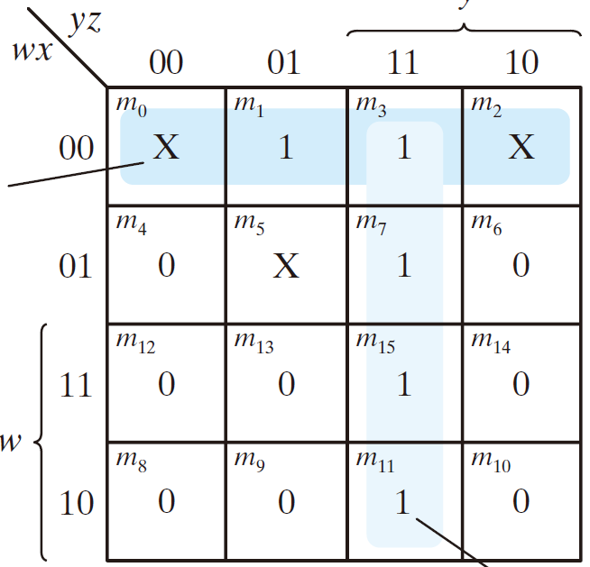
  Don’t care condition
  F (w, x, y, z) = ∑(1, 3, 7, 11, 15)
  d(w, x, y, z) = ∑(0, 2, 5)

Slide 127
  Don’t care condition
  F (w, x, y, z) = ∑(1, 3, 7, 11, 15)
  d(w, x, y, z) = ∑(0, 2, 5)
  F = yz + w'x'

Slide 128
  Don’t care condition
  F (w, x, y, z) = ∑(1, 3, 7, 11, 15)
  d(w, x, y, z) = ∑(0, 2, 5)

Slide 129
  Don’t care condition
  F (w, x, y, z) = ∑(1, 3, 7, 11, 15)
  d(w, x, y, z) = ∑(0, 2, 5)
F = yz + w'z

